Slide 1
Mindfulness and attention: A study of the influence of well-being on cognitive functioning
Ella Bremmer, Pierce Johnson
Notes:
Pierce introduces

Slide 2
Overview
Background
Mindfulness
Attention
Life Satisfaction
Our Research
Hypotheses
Visual Search
Surveys
The LINCD Lab
Attendance
Notes:
Pierce

Slide 3
What is Mindfulness?
Attention, awareness, and presence in the moment
Translated from the Pali word “sati”: awareness, attention, and remembering
Others conceptions: “a mental state achieved by focusing one’s awareness on the present moment, while calmly acknowledging and accepting one’s feelings, thoughts, and bodily sensations”
Notes:
Ella
Mindfulness is about being aware of where your mind is from one moment to the next, with gentle acceptance. (Germer, Siegel, & Fulton, 2005)
- give in real time experience of my mindful experience
` - show them how they can be mindful, you could be mindful of how your bottom feels on the chair you're sitting on, focusing on my words with deep attention, noticing a thought pop into your might.)
The whole point is that you are aware of this attention.
You go about your day and you are naturally aware of many things in each moment, but mindfulness is about being AWARE of this awareness. Watching closely to where the spotlight of your attention goes, and then allowing it to be in line with a state of acceptance.
The term mindfulness is an English translation of the Pali word sati. Pali was the language of Buddhist psychology 2,500 years ago, and mindfulness is the core teaching of this tradition. Sati connotes awareness, attention, and remembering. (Germer)
The Oxford Online Dictionary defines mindfulness as “a mental state achieved by focusing one’s awareness on the present moment, while calmly acknowledging and accepting one’s feelings, thoughts, and bodily sensations, used as a therapeutic technique http://www.oxforddictionaries.com
(as mentioned earlier…. Further give examples)
Give examples of mindfulness
Eating with close attention to texture, taste
Breathing techniques
Walking noticing the way your feet feel on the ground
Showering and noticing the way the water feels when it hits you, its temperature, pressure
Listening to someone talk and paying close attention to every word they say

Slide 4
Practicing Mindfulness
Breathe through your nostrils, and focus on the sensations involved, around the nose, in the lungs, the belly. Keep your attentional awareness of this process for one minute
Were you able to stay focus?
Did you find your mind wandering?
Notes:
Ella

Slide 5
What is Mindlessness?
A state of unawareness, of going through the motions with little or no conscious awareness of your surroundings or your inner states.
Mind Wandering
Breaking or spilling things because of carelessness
Forgetting someone’s name when you meet
Finding ourselves preoccupied with the future or the past
Notes:
Ella:
Mindlessness is when you act or think automatically, without really paying attention to what’s happening right now.
Milk in the cupboard scenario
Walking into a room and forgetting what you went in their for
- driving and going the wrong way because you weren’t being mindful of your driving, your attention was elsewhere
having a conversation with someone and zoning out
Mindlessly scrolling
Mindlessly eating
Mindlessness is compared to more familiar concepts such as habit, autopilot, and automatic processing. This occurs with little or no conscious awareness.
When you are in a mindless state, you rely too much on what you’ve learned or noticed in the past, so you miss new or different things in the current situation.
Langer, E. J. (1992).
More Examples of mindlessness
(on the slide)

Slide 6
Awareness and Mindfulness
Consciousness encompasses both awareness and attention. Awareness is the background “radar” of consciousness
To have “present awareness”, a special kind of awareness of continuously having a sense of composure of mental and emotional functioning, and acceptance of the stream of perceived experiences that spontaneously arise.
Notes:
Pierce
1st quote is Brown and Ryan, 2nd quote is Grossman
Grossman
Consciousness encompasses both awareness and attention. Awareness is the background “radar” of consciousness, continually monitoring the inner and outer environment
To have “present awareness”, a special kind of awareness of continuously having a sense of composure of mental and emotional functioning, and acceptance of the stream of perceived experiences that spontaneously arise.
Mindfulness is achieved by a process of having met at least four necessary conditions:
intentionality,
focus on the present moment
awareness of the attentional focus: bodily sensations, thoughts, sensory stimuli (sounds, sights)
& a stance of acceptance toward whatever has arien into this awareness as the direct consequence of the attentional focus
In this state of acceptance of the stream of experience that spontaneously arise in each moment, the usual analysis, judgement, evaluation, and even rumination are replaced with attitudes of patience, openness, lack of prejudice, tolerance, and kindness
- This is often summarized in literature as “acceptance” and “non-judgment”

Slide 7
Why Mindfulness?
Awareness of one’s present moment is not typically practiced in our daily lives
Mindless states predicts future unhappiness
Mindfulness meditation may work by improving well-being
Notes:
Ella
Having awareness of one’s present moment experience is not something we typically practice, and as a result we unintentionally allow our minds wander, running on autopilot.
Mindfulness is a skill that allows us to be less reactive to what is happening in the moment. It is a way of relating to all experience, positive, negative and neutral. To be mindful is to wake up, to recognize what is happening in the present moment with a friendly attitude.
Unfortunately, were rarely mindful. We are usually caught up in distracting thoughts or in opinions
Ex: someone says something neg. You ruminate, by the end of the day you are extremely anxious and mad and youre not even entirely sure why
Mindfully notice the thoughts, accept that they are coming up into your awareness, and mindfully choose to come back to whatever you are doing in the present moment, eating, studying, talking to a friend, walking outside.
Now you just get to be here, and not in your head where it seems to be a negative place at the moment.
the mindless states in our daily life experience have been demonstrated to be undesirable. For example, one study showed that our minds wander approximately 47% of the time and that mind wandering predicts subsequent unhappiness (Killingsworth & Gilbert 2010).
It is proposed that the mechanism through which mindfulness meditation exerts its effects is a process of enhanced self-regulation, including attention control, emotion regulation and self-awareness.
Mindfulness meditation has potential for the treatment of clinical disorders and might facilitate the cultivation of a healthy mind and increased well-being.
This kind of simple attention can have a deeply transformative effect on our daily lives (Germer, Siegel, & Fulton, 2005)

Slide 8
Attention
Competing theories of attention: top-down, or bottom-up?
Implications for mindfulness?
Is ability to focus on single features increased?
Attention is a process of focusing conscious awareness, providing heightened sensitivity to a limited range of experience
Is ability to filter out distracting information improved?
Notes:
Pierce
The anterior cingulate cortex is the region associated with attention in which changes in activity and/or structure in response to mindfulness meditation are most consistently reported. (Tang, Y.-Y., Hölzel, B. K., & Posner, M. I. 2015)

Slide 9
Life Satisfaction
Mindfulness is a skill that allows us to be less reactive to what is happening in the moment
Replacing judgment with non-judgment and acceptance
Connection to attention: filter out the distractors, reduce cognitive fatigue and stress
Notes:
Pierce
The reasoning for comparing life satisfaction and mindfulness:
if we are less upset by events in our lives, our suffering will decrease. But how can we be less disturbed by unpleasant experiences? Life includes pain. Don’t the body and mind instinctively resist or avoid painful experiences? (Germer)
(Grossman, P. 2015)

Slide 10
Our Research:
Hypotheses:
Mindfulness correlated with life satisfaction
Higher mindfulness score is correlated with higher visual search performance
Visual Search
Surveys:
Mindful Attention Awareness Scale (MAAS; Brown & Ryan, 2003)
Satisfaction with Life Scale (SWLS; Diener et al., 1985)
Big Five Inventory (BFI;
Notes:
Ella and Pierce
Attention and mindfulness
Mindfulness and life satisfaction
What are the relationships we would expect to see in our study
We hypothesis :
Visual search requires attention, working memory capacity, greater attentional capacity and abilities to sustain attention

Slide 11
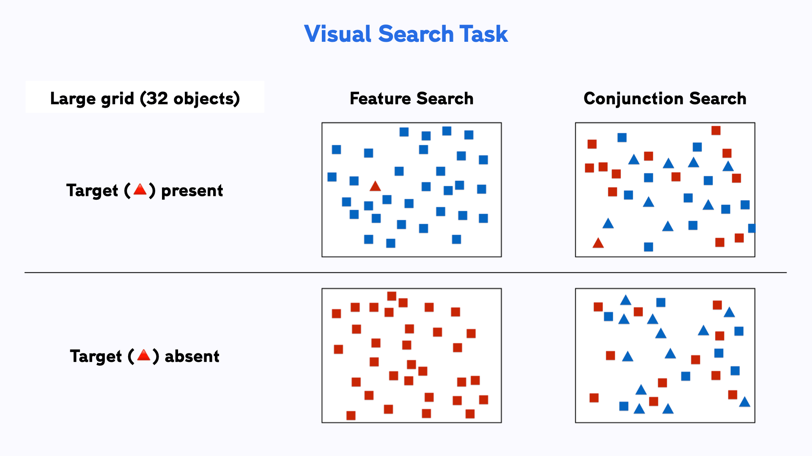
Visual Search
Notes:
Pierce

Slide 12
Our Research:
Hypotheses:
Mindfulness correlated with life satisfaction
Higher mindfulness score correlated with higher visual search performance
Visual Search
Surveys:
Mindful Attention Awareness Scale (MAAS; Brown & Ryan, 2003)
Satisfaction with Life Scale (SWLS; Diener et al., 1985)
Big Five Inventory (BFI;
Notes:
Ella and Pierce
Attention and mindfulness
Mindfulness and life satisfaction
What are the relationships we would expect to see in our study
We hypothesis :
Visual search requires attention, working memory capacity, greater attentional capacity and abilities to sustain attention

Slide 13





Interested in Our Work? Join the LINCD Lab!
Memory
Attention
Color perception
Music preferences
Mindfulness
Social influence of music
Reading and remembering music
Notes:
Pierce

Slide 14

Attendance
Please scan the QR code to record you attendance!
Notes:
Pierce

Slide 15
References
Brown, K. W., & Ryan, R. M. (2003). Mindful Attention Awareness Scale. https://doi.org/10.1037/t04259-000
Creswell, J. D. (2017). Mindfulness Interventions. Annual Review of Psychology, 68(Volume 68, 2017), 491–516. https://doi.org/10.1146/annurev-psych-042716-051139
Diener, E., Emmons, R.A., Larsen, R.J., & Griffin, S. (1985). Development of the Satisfaction with Life Scale. Journal of Personality Assessment, 49(1), 71–75.
Germer, C. K., Siegel, R. D., & Fulton, P. R. (Eds.). (2005). Mindfulness and psychotherapy. Guilford Press
Grossman, P. (2015). Mindfulness: Awareness Informed by an Embodied Ethic. Mindfulness, 6(1), 17–22. https://doi.org/10.1007/s12671-014-0372-5
Langer, E. J. (1992). Matters of mind: Mindfulness/mindlessness in perspective. Consciousness and Cognition, 1(3), 289–305. https://doi.org/10.1016/1053-8100(92)90066-J
Oxford University Press. (n.d.). Mindfulness, n. In Oxford English dictionary. Retrieved October 25, 2025, from https://doi.org/10.1093/OED/5972187471
Tang, Y.-Y., Hölzel, B. K., & Posner, M. I. (2015). The neuroscience of mindfulness meditation. Nature Reviews Neuroscience, 16(4), 213–225. https://doi.org/10.1038/nrn3916

